Slide 1
Predicting the Prices of Oil and Gold: Background Report
Group 8: Ayush, Benjamin, Komal, Sreevathsan
Stony Brook University

Slide 2
Outline
Challenge
History/Background
Data sets
Images/Video
Baseline Model
Initial Prediction
Next Steps

Slide 3
Challenge
Predict the prices of oil and gold in October, November and December.

Slide 4
OIL

Slide 5
Challenge: Predicting Oil Prices
Non-renewable resource occurring in the earth
Extracted and refined into petroleum products
Most actively and heavily traded commodity (~10% of the total world trade)
Oil price is basically determined by supply and demand
Strongly influenced by many other factors - weather, economy, geopolitics, etc

Slide 6
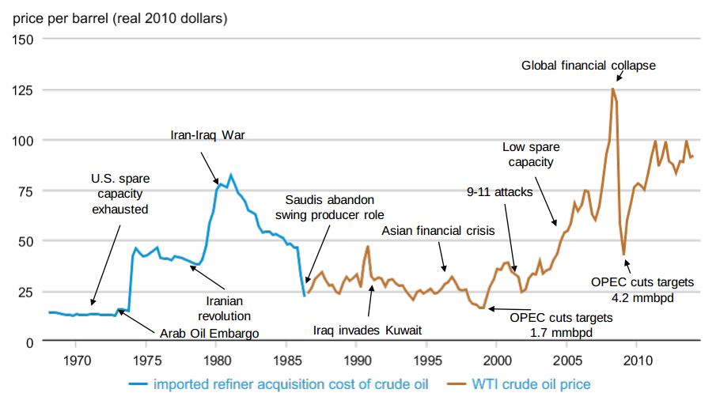
Background: History of Oil Prices
Source: EIA
Notes:
Both crude oil and petroleum product prices can be affected by events that have the potential to disrupt the flow of oil and products to market, including geopolitical and weather-related developments.
A drop in demand for oil during the global financial collapse in 2008 led to a drop in oil prices as well.
These types of events may lead to actual disruptions or create uncertainty about future supply or demand, which can lead to higher volatility in prices.

Slide 7
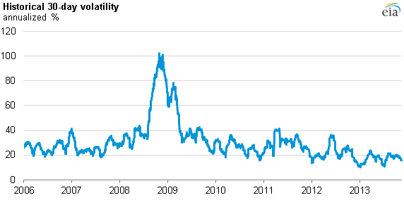
Challenge: Predicting Oil Prices
Very high volatility and sensitivity
Relationship between oil prices and the factors might vary over time

Slide 8
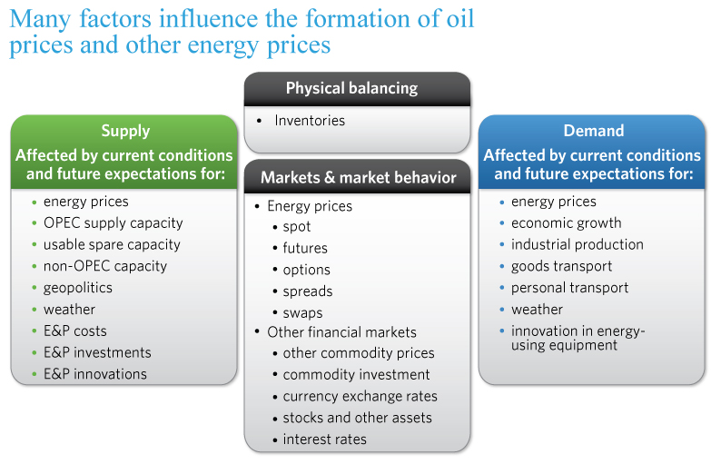
History/Background: Oil
Source: EIA

Slide 9
History/Background: Oil
Major factors affecting oil prices:
Supply: OPEC (Organization of the Petroleum Exporting Countries), Non-OPEC
Spare Capacity
Demand
Notes:
Supply: OPEC - An organization of 12 countries in the middle east who coordinate to unify petroleum policies. OPEC member countries produce about 40% of the world’s crude oil. OPEC’s actions can an do influence the prices of oil. For example, any changes in the oil production in Saudi Arabia, OPEC’s largest producer, frequenly affects prices.
The behavior of oil prices depends not only on current supply and demand, but also on projected future supply and demand. OPEC adjusts member countries' production targets based on current and expectations of future supply and demand.
Oil supply from non-OPEC countries represents about 60% of the total crude oil production.
Dollar - Oil is traded in Dollars, so any variation in the Dollar Exchange rate leads to fluctuations in the price of oil. There is an inverse relationship between the exchange value of the dollar relative to the other currencies and oil prices. A depreciation in the value of dollar causes the price of oil to fall in the countries outside the US, thus increasing the demand, which in turn will rise oil prices. There are several other possible explanations about how the US Dollar can affect the prices of oil. Despite all these possible explanations, the correlation between the US Dollar and Oil Prices has not been stable over the years.
Stock Price: As economic conditions improve (or worsen), earnings for companies increase (or decrease) and demand for commodities as raw materials rise (or fall) as well.
Seasonality:
Geopolitics:

Slide 10
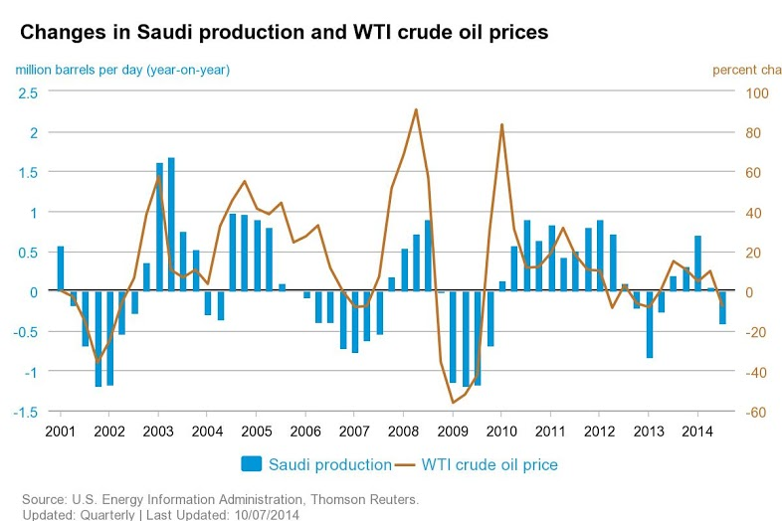
History/Background: Oil
Source: EIA
Notes:
For example, any changes in the oil production in Saudi Arabia, OPEC’s largest producer, frequently affects prices.

Slide 11
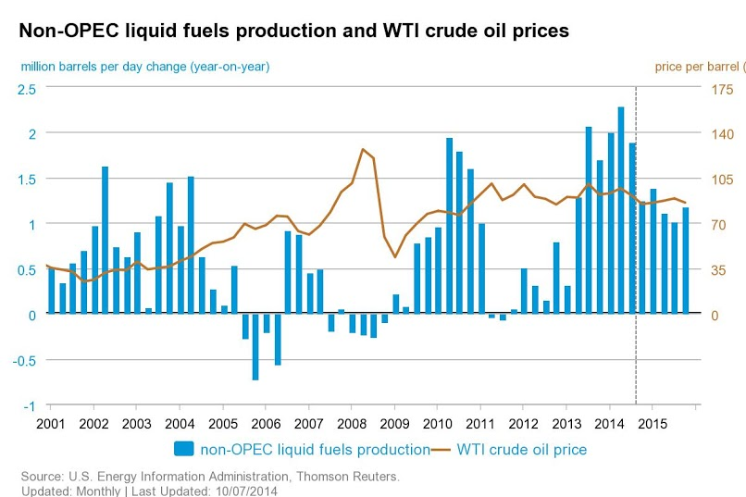
History/Background: Oil
Source: EIA
Notes:
This chart shows that net increases in non-OPEC production were very small from 2005 to 2008. This lack of additional supplies from non-OPEC countries contributed to tighter markets in this period.

Slide 12
History/Background: Oil
Major factors affecting oil prices:
US Dollar Index
Stock Price
Economic Growth - GDP
Seasonality (weather)
Geopolitics
Notes:
Dollar - Oil is traded in Dollars, so any variation in the Dollar Exchange rate leads to fluctuations in the price of oil. There is an inverse relationship between the exchange value of the dollar relative to the other currencies and oil prices. A depreciation in the value of dollar causes the price of oil to fall in the countries outside the US, thus increasing the demand, which in turn will rise oil prices. There are several other possible explanations about how the US Dollar can affect the prices of oil. Despite all these possible explanations, the correlation between the US Dollar and Oil Prices has not been stable over the years.
Stock Price: As economic conditions improve (or worsen), earnings for companies increase (or decrease) and demand for commodities as raw materials rise (or fall) as well.
Seasonality:
Geopolitics:

Slide 13
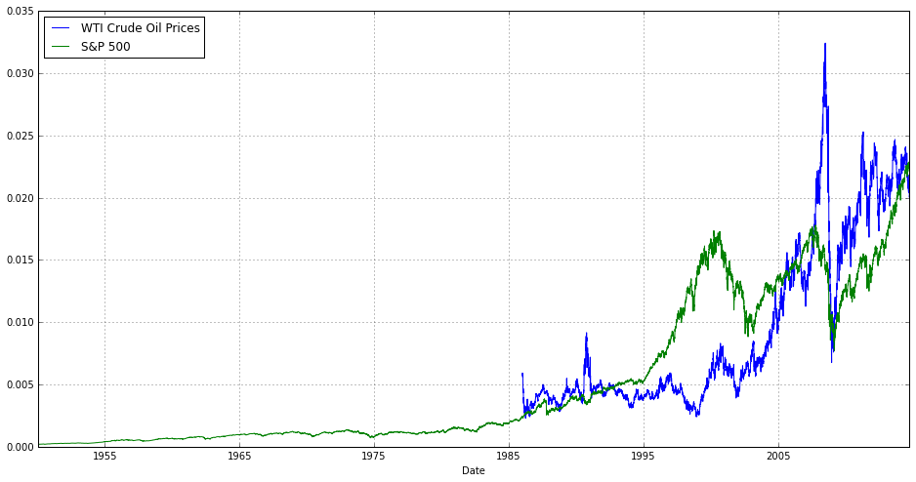
History/Background: Oil

Slide 14
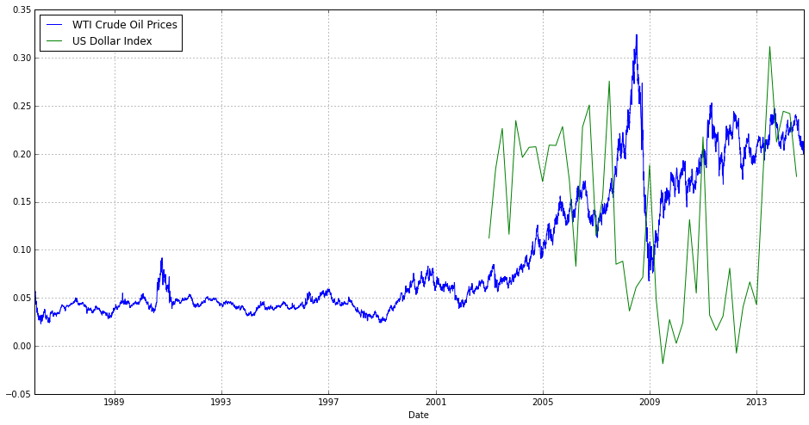
History/Background: Oil

Slide 15
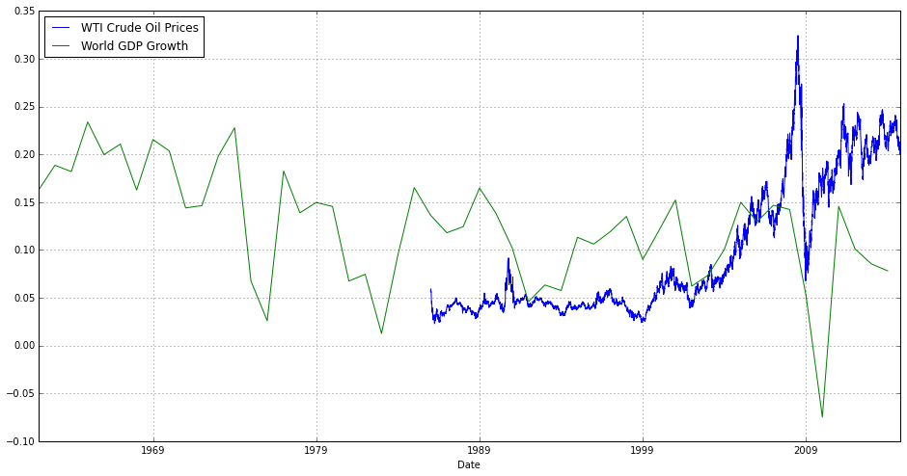
History/Background: Oil

Slide 16
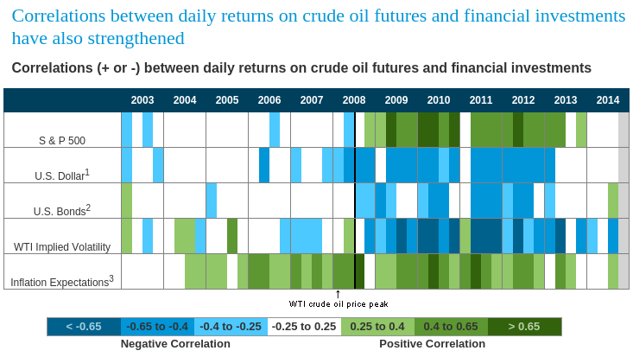
History/Background: Oil
Source: EIA

Slide 17
Literature Review
Methodologies to predict oil prices:
Quantitative Methods
Data Driven - based on historical oil price data
Linear Time Series
Nonlinear Time Series
Structural
Supply-Demand Models
Notes:
Time series models predict future oil prices based on historical oil price data.
The types of models are generally used when
1) data exhibit a systematic pattern such as autocorrelation.
2) the number of possible explanatory variables is large, and their interactions suggest and exceedingly complex structural model,
3) forecasting the dependent variable requires the prediction of the explanatory variables, which may be even more involved than forecasting the dependent variables itself.
[dependant variables: variables that we eventually want to forecast. The observed variables, explanatory variables: the variables that do the forecasting, preferably independent of each other]

Slide 18
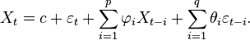
Literature Review
Linear time series
[1] Morana, Claudio. "A semiparametric approach to short-term oil price forecasting." Energy Economics 23.3 (2001): 325-338.
ARMA (Autoregressive moving average model)
Their approach works best for short term price prediction.
Models oil prices based on the uncertainty of the market.
ARCH (Autoregressive conditional heteroskedasticity)
GARCH (Generalized autoregressive conditional heteroskedasticity)
Notes:
ARCH models are employed commonly in modeling financial time series that exhibit time-varying volatility clustering, i.e. periods of swings followed by periods of relative calm.
ARMA (Autoregressive moving average model): These models have two parts, an autoregressive part and a moving average part.
ARCH (Autoregressive conditional heteroskedasticity): They are used whenever there is reason to believe that, at any point in a series, the error terms will have a characteristic size, or variance. Uses historical error values.
GARCH (Generalized autoregressive conditional heteroskedasticity): ARCH model plus the summation of the variance for the time series history.

Slide 19
Literature Review
Nonlinear time series: EMD
[2] Yu, Lean, Shouyang Wang, and Kin Keung Lai. "Forecasting crude oil price with an EMD-based neural network ensemble learning paradigm." Energy Economics 30.5 (2008): 2623-2635.
They assume that data has co-existing modes of oscillation simultaneously.
The time series is decomposed into several independent oscillatory functions from high to low frequency.
A three layer feed forward neural network model is used to model each of theses functions

Slide 20
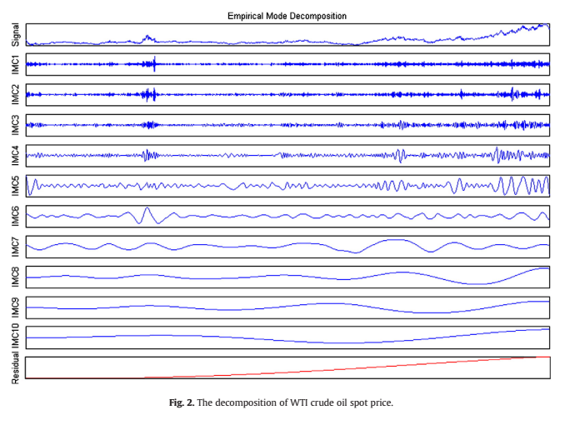
Literature Review

Slide 21
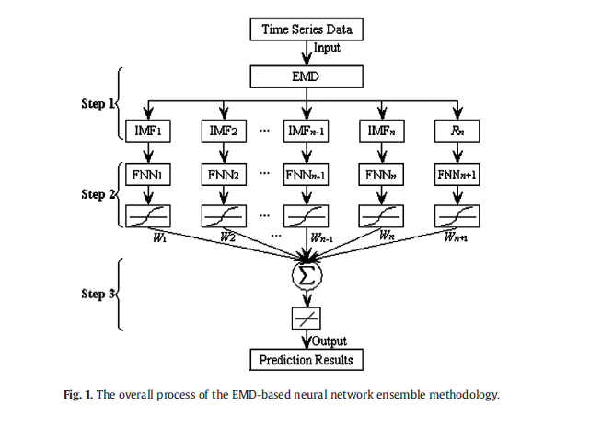
Literature Review

Slide 22
Literature Review
Nonlinear time series: SVM
[3] Xie, Wen, et al. "A new method for crude oil price forecasting based on support vector machines." Computational Science–ICCS 2006. Springer Berlin Heidelberg, 2006. 444-451.
Method works in four phases:
Data sampling
Data preprocessing
Training and Learning(using SVM architecture and parameters)
Final future price forecasting.
Results are better than the ARIMA(Autoregressive integrated moving average) and BPNN(back propagation neural networks) using RMSE(root mean square error) as the evaluation parameter.
Notes:
They propose a new method for crude oil price forecasting using SVM.
Use WTI spot prices from January 1970 to December 2003 (a total of 408 observations).

Slide 23
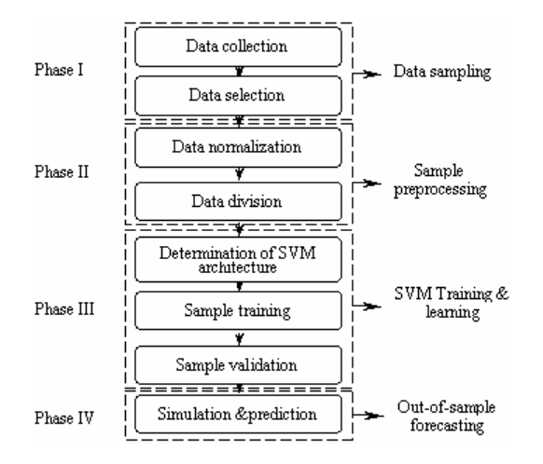
Literature Review
Flowchart of SVM based forecasting system

Slide 24
Literature Review
Nonlinear time series: ANN
[4] Godarzi, Ali Abbasi, et al. "Predicting oil price movements: A dynamic Artificial Neural Network approach." Energy Policy 68 (2014): 371-382.
Use a dynamic ANN approach known as Non-Linear Autoregressive model with eXogenous input (NARX).
NARX - special form of ANN which considers the factor of time
Parameters: Crude Oil Price, Gold Price, Energy Production, GDP Growth, Energy Use, Oil Rent, Final Consumption expenditure
When compared to linear time series methods and static ANN methods NARX achieves a better R² value and MAE value(mean absolute error).

Slide 25
Data Sets: Oil
Crude Oil Benchmarks
West Texas Intermediate (USA)
Brent (North Sea)
Dubai/Oman (Middle East)
Notes:
West Texas Intermediate (WTI), also known as Texas light sweet, is a grade of crude oil used as a benchmark in oil pricing. This grade is described as light because of its relatively low density, and sweet because of its low sulfur content.
Brent Crude is a major trading classification of sweet light crude oil that serves as a major benchmark price for purchases of oil worldwide. Brent Crude is extracted from the North Sea.
Dubai Crude is a medium sour crude oil extracted from Dubai. Dubai Crude is used as a price benchmark or oil marker because it is one of only a few Persian Gulf crude oils available immediately. Dubai Crude is a medium oil.

Slide 26
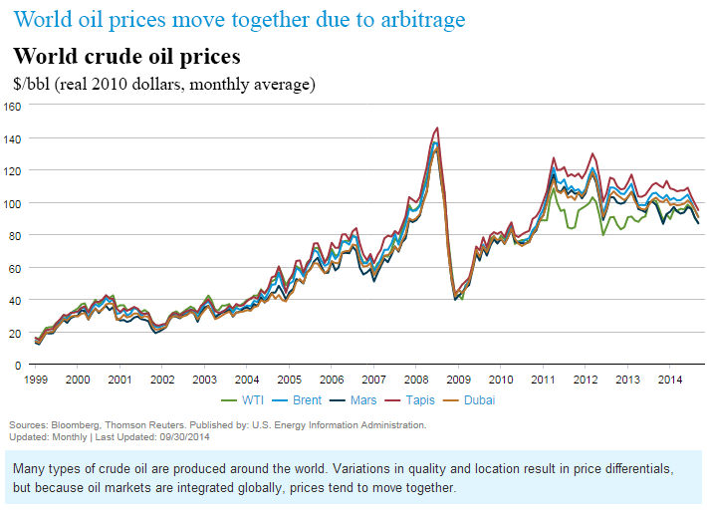
Data Sets: Oil
Notes:
Cushing is the trading hub for West Texas Intermediate WTI, a blend of US light sweet crude oil streams.^{[9]} traded on the New York Mercantile Exchange^{[12]}
In February 2011, WTI was trading around $85/barrel while Brent was at $103/barrel. The reason most cited for this difference was that Cushing had reached capacity, due to a surplus of oil in the interior of North America. At the same time, Brent moved up in reaction to civil unrest in Egypt and across the Middle East. Since WTI-priced stockpiles at Cushing could not easily be transported to the Gulf Coast, WTI crude was unable to be arbitraged in bringing the two prices back to parity. Oil prices at coastal areas of the US were closer to Brent than to WTI.
Increased U.S. light sweet crude oil production combined with limited pipeline capacity to move the crude from production fields and storage locations, including Cushing, Oklahoma, the delivery point for the Nymex light sweet crude oil contract, to refining centers put downward pressure on the price of WTI crude oil.
More recently, expansions in U.S. crude oil infrastructure have eased the downward pressure on the price of WTI. Since mid-2012, significant pipeline takeaway capacity has been added at Cushing, enabling crude oil to flow to and from the trading hub more easily.
http://www.eia.gov/todayinenergy/detail.cfm?id=11891
http://blogs.wsj.com/marketbeat/2011/06/14/oil-price-conundrum-why-is-brent-so-much-more-costly-than-wti-vs-west-texas/
http://en.wikipedia.org/wiki/West_Texas_Intermediate

Slide 27
Data Sets: Oil
Historical Oil Prices
Other factors
World GDP/GDP Growth
S&P 500
Gold Price
US Dollar Index
Supply-Demand - BDI (Baltic Dry Index)
Notes:
US Dollar Index: It is a weighted geometric mean of the dollar's value compared only with a "basket" of 6 other major currencies
S&P 500: Standard and Poor 500. The S&P 500 is one of the most commonly used benchmarks for the overall U.S. stock market. It is a stock market index based on the market capitalizations of 500 large companies having common stock listed on the NYSE.
We are more concerened about the factors affecting the volatility and the short term prices changes in oil.
Baltic Dry Index: the index provides "an assessment of the price of moving the major raw materials by sea”. It is based on dry cargo based freight rates. It is a leading indicator for economic growth. It is issued daily and it can be a good indicator for short term

Slide 28
Baseline Models
Model 0.0 - Assuming the price to be constant
Model 0.1 - Average of the price of last k(=3) days
Model 0.2 - Model As per PSO Paper
Model 0.3 - Weighted average of the last k(=3) days. Weight of the ith day in the history is (k-i+1)
Model 0.4 - Weighted average of the last k(=3) days. Weight of the ith day in the history is (k-i+1)^3
Notes:
Please dont worry about this now. I will write down the final results. I am trying out a few things with the data. ‘playing around with it’ :p :P

Slide 29
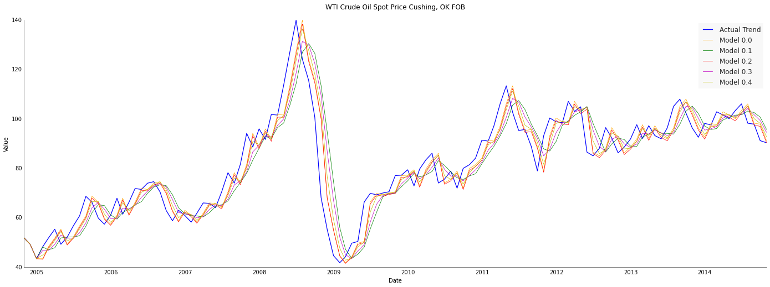
Initial Prediction - Oil

Slide 30
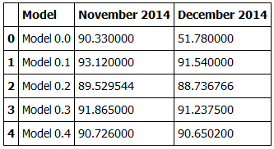
Initial Prediction - Oil
Oil Forecast Price ($ per barrel)

Slide 31
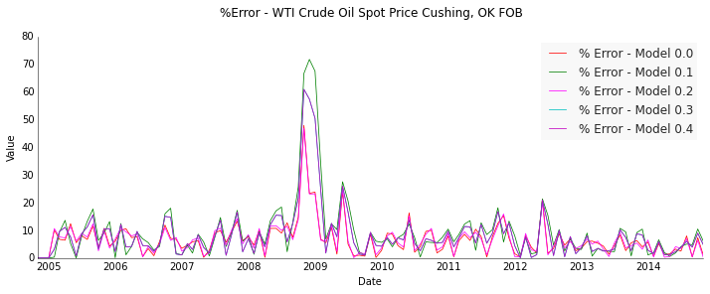
Initial Prediction - Oil
Error Variations

Slide 32
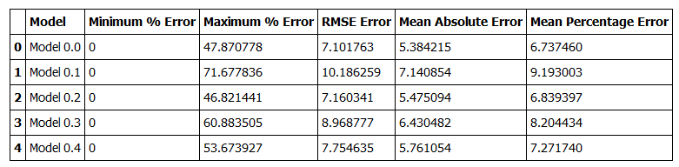
Initial Prediction - Oil
Oil Price Prediction Error Metrics

Slide 33
Next Steps
Developing a model considering all the factors
Use Machine learning algorithms for prediction

Slide 34
GOLD

Slide 35

Challenge: Predicting Gold Prices
Dynamic, Fluctuations, high volatility
Multiple factors affecting it
Weight of each parameter
Dependency of parameters
Source: Flickr
Notes:
Dynamic, Fluctuations and high volatility.
Several unique and different factors that affect gold prices and the exact coefficient of their correlation with gold prices are not yet properly known(or understood).
It is very hard to determine the relative importance of the parameters.
Gold price is related to the inflation and decrease in purchasing power of a currency. And almost everything that affects inflation affects gold price(so lots of factors, once again!).
The variables that affects gold price are themselves not independent.(i.e. they have correlations among themselves).

Slide 36
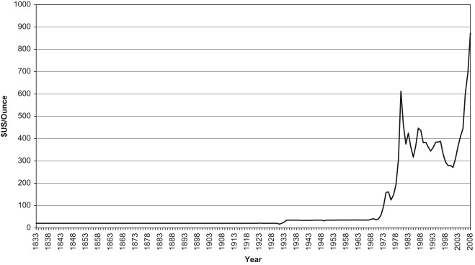
History/Background: Gold
Notes:
1934: Roosevelt fixed the gold price from $20.67 to $35. 1968, with the breakdown of Bretton Woods Currency Arrangement, the gold price was then allowed to be market determined. Then we have 2 major depressions in 1968 and 2008, that’s why we see two gold price jumps.

Slide 37
History/Background: Gold
Factors affecting price of gold
Crude Oil Price
Commodity Research Bureau future index (CRB)
Money Supply (M1)
US Dollar index (USDX)
Inflation rate (INF)
USD/Euro Foreign Exchange Rate (EURO/USD)
New York Stock Exchange (NYSE)
Standard and Poor 500 (SPX)
Treasury Bill (T-BILL)
Notes:
Crude Oil Price: There is an approximately 85-90 percent correlation between gold prices and crude oil prices.
CRB Index: There is a positive correlation in general of CRB index with gold price.
M1: There is a positive correlation between M1 and gold price.
USD Index: USDX has a negative correlation with gold price in the long run, though the coefficient values vary.
CRB index is commodity futures price index, and it is composed of 28 commodities.
M0 = Federal Reserve Notes + US Notes + Coins.
The total amount of M0 (cash/coin) outside of the private banking system plus the amount of demand deposits, travelers checks and other checkable deposits.
In general inflation increases gold price. That is the primary reasons why these indices affect gold price. They do it by affecting inflation.

Slide 38
Literature Review
Oil and Inflation
[1] Shafiee Shahriar, and Erkan Topal. “An overview of global gold market and gold price forecasting.” Resources Policy 35.3 (2010): 178-189
Macroeconomic factors affecting prices of gold
85% correlation between oil prices and gold prices
6% correlation between inflation rate and gold price
Long-term trend reverting jump and dip diffusion model
Notes:
This paper talks:1.Oil prices and inflation are two main macroeconomics factors that affect gold prices. There is an approximately 85% correlation between oil prices and gold prices! The increase of oil price would lead to the increase of gold price, but vice versa.
[Need info for Long-term trend reverting jump and dip diffusion model??]

Slide 39
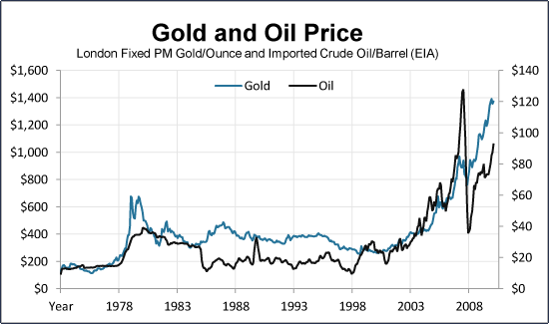
Literature Review
Correlation between gold and oil prices
Source: Shafiee, Shahriar, and Erkan Topal. "An overview of global gold market and gold price forecasting." Resources Policy 35.3 (2010): 178-189.
Notes:
From Shafiee’s paper (Highly correlation between oil price and gold price)

Slide 40
Literature Review
Multiple Linear Regression Model
[2] Ismail, Yahya and Shabri. “An overview of global gold market and gold price forecasting.” American Journal of Applied Sciences 6 (8): 1509-1514, 2009
Consider 7 factors: Commodity Research Bureau future index (CRB); USD/Euro Foreign Exchange Rate (EUROUSD); Inflation rate (INF); Money Supply (M1); New York Stock Exchange (NYSE); Standard and Poor 500 (SPX); Treasury Bill (T-BILL) and US Dollar index (USDX)
Develop 2 models based on 4 key factors
Notes:
Prais-Winsten procedure was employed to estimate the regression coefficients[5-7]
Commodity Research Bureau future index (CRB); USD/Euro Foreign Exchange Rate (EUROUSD); Inflation rate (INF);
Money Supply (M1); New York Stock Exchange (NYSE); Standard and Poor 500 (SPX); Treasury Bill (T-BILL) and US Dollar index (USDX)
.

Slide 41
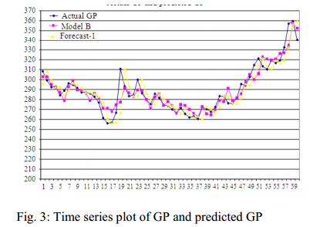
Literature Review

Slide 42
Literature Review
Particle Swarm Optimization
[3] Hadavandi, Ghanbari and Abbasian-Naghneh. “Developing a Time Series Model Based on Partical Swarm Optimization for Gold Price Forecasting” Third International Conference on Business Intelligence and Financial Engineering (2010)
GP(k) = α₁ GP(k-1)+ α₂GP(k-2)+ α₃
GP(k) is Gold price in kth day.
PSO algorithm(which is an evolutionary computation technique based on the simulation of bird flocking in 2 dimensions) is used for estimation of parameters vector (α₁, α₂, α₃).
They use: α₁= 0.976, α₂=.01373 and α₃ = 0.1157. Their method seems better than ARIMA, ANN and OLS methods.
The main flaw is that the algorithm just looks at the prices for the last two days!!

Slide 43
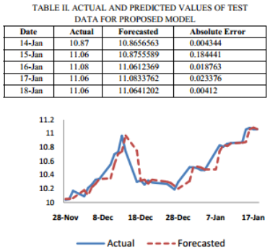
Literature Review

Slide 44
Literature Review
Comparison
Which method is more accurate?
Which method would be suitable for short term (our actual modelling)
Notes:
Linear Regression models may not be applicable for long run, but they beat in accuracy.
Hybrid methods - EMD+PSO+SVM is better in these aspects

Slide 45

Data Sets: Gold
Benchmarking the price of gold
London Gold Fix: Five members two fixes daily
Spot Price
Source: Reuters
Notes:
It is also significant to know the gold price benchmark - London Gold Fix. It is a twice-daily telephone meeting of representatives from five bullion-trading firms of the London bullion market since 1919. 5 Members: Scotia-Mocatta, Barclays Capital, Deutsche Bank, HSBC and Société Générale.
Spot Price: The current price at which a particular security can be bought or sold at a specified time and place.

Slide 46
Data Sets: Gold
Historical Gold Prices
World Gold Council
Other parameters
USD-EURO Exchange Rate
Inflation Rate
US Dollar Index
etc
Notes:
https://www.quandl.com/WGC/GOLD_DAILY_USD-Gold-Prices-Daily-Currency-USD

Slide 47
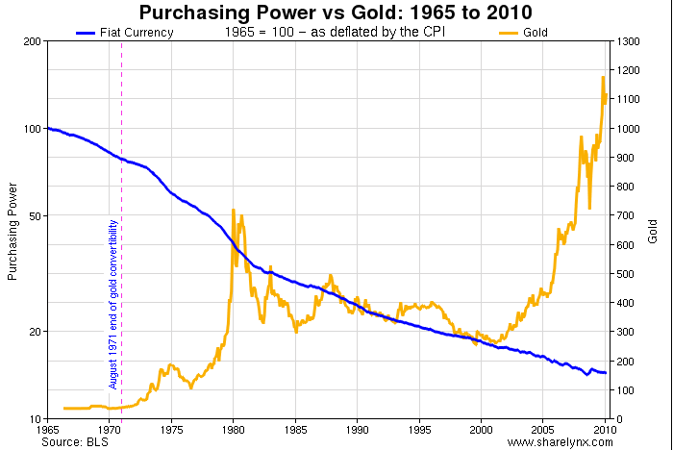
Images/Video
Notes:
Because the purchasing power is affected by Money supply (When the government decides to increase the supply of money in circulation, each new dollar printed weakens the value of the previous dollar. ) It can be viewed as the correlation between gold price and Money Supply/US Dollar Index. Source of this graph https://www.flickr.com/photos/survivalbros/5160598974/in/photolist-8VtUA8-8VwWam-8S2pUw-8ZgQSR-9M2QU4-bg6vWP-8S2qho-9grVVh-a9VVG6-ee3z68-ee4Hi6-ee3z26-e72mtR-bJh2GH-czeNdw-ee3x5K-aFzPhr-69SW3F-69X7xN-dYAmRF/

Slide 48
Baseline Models
(same as oil)
Model 0.0 - Assuming the price to be constant
Model 0.1 - Average of the price of last k(=3) days
Model 0.2 - Model As per PSO Paper
Model 0.3 - Weighted average of the last k(=3) days. Weight of the ith day in the history is (k-i+1)
Model 0.4 - Weighted average of the last k(=3) days. Weight of the ith day in the history is (k-i+1)^3
Notes:
Please dont worry about this now. I will write down the final results. I am trying out a few things with the data. ‘playing around with it’ :p :P

Slide 49
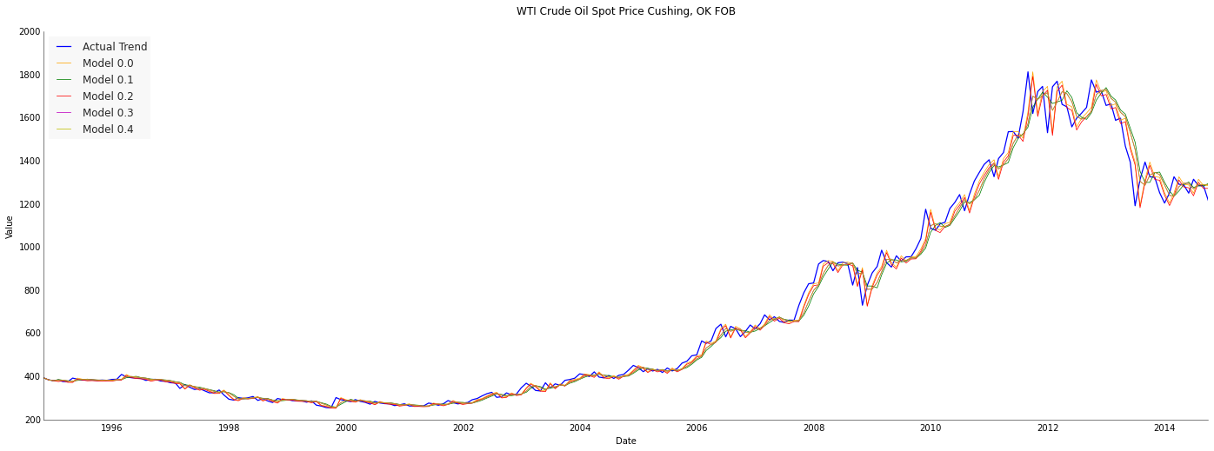
Initial Prediction - Gold

Slide 50
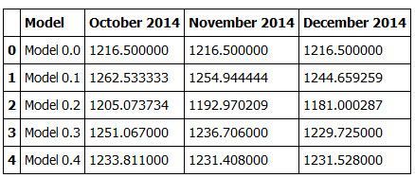
Initial Prediction - Gold
Gold Forecast Price ($/o.z.)

Slide 51
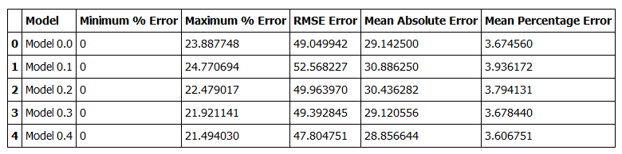
Initial Prediction - Gold
Gold Price Prediction Error Metrics

Slide 52
Next Steps
Developing a model considering all the factors
Use Machine learning algorithms for prediction

Slide 53
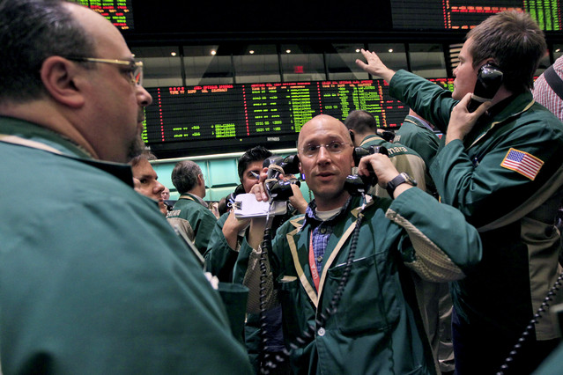
Images/Video
Traders work the crude oil options pit at the New York Mercantile Exchange in New York.
Source: Bloomberg

Slide 54
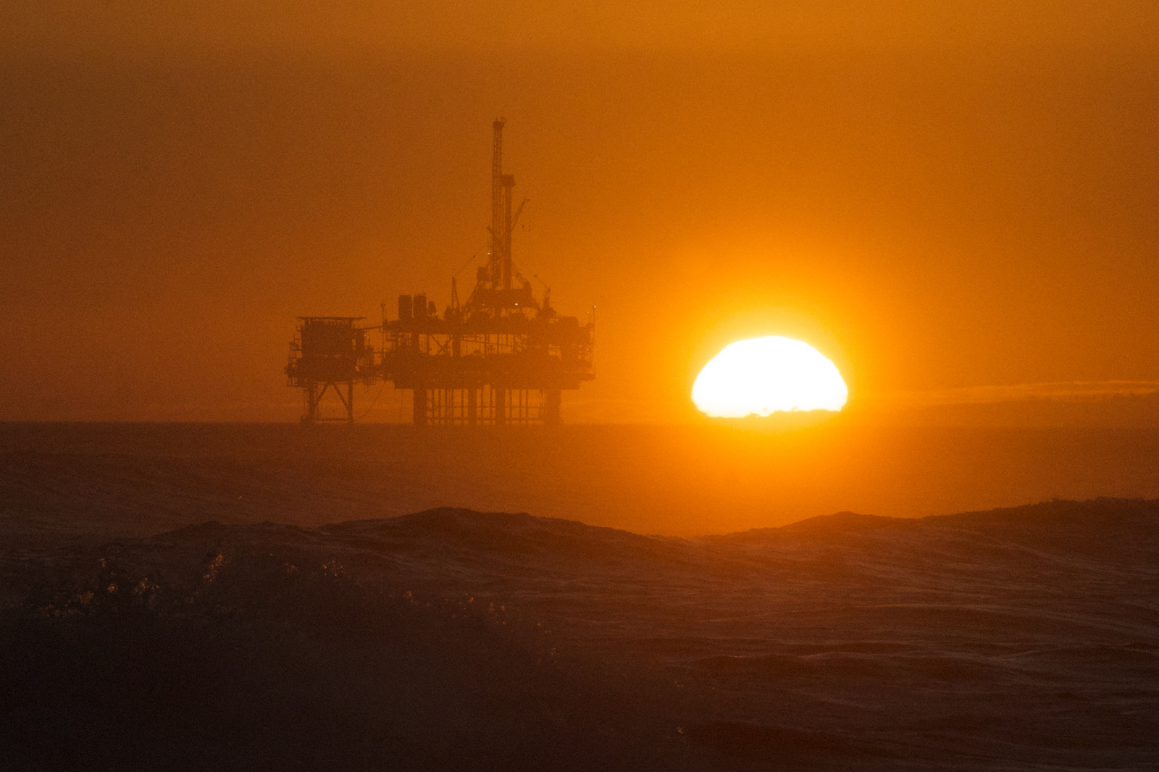
Images/Video
Oil Rig at Huntington
Source: Flickr

Slide 55
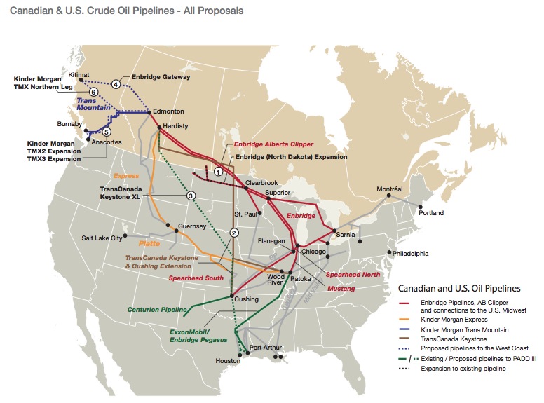
Images/Video
Canadian and US Crude Oil Pipelines
Source: Canadian Association of Petroleum Producers

